Slide 1
SDT for Arrays

Slide 2
Addressing array elements
Array can be easily accessed if the elements are in consecutive locations
i^{th} element = base + (i –low) * w
width = w
Base – relative address of A[low]
i^{th} element = i *w + (base – low * w)

Slide 3
Addressing of array elements
i * w – evaluated during compile time
c = base – low * w is evaluated during run time
A[i] – address = i *w + c

Slide 4
Arrays
Row major
Accessed row by row
For 2 d arrays – for every row, all the columns are accessed and then second row is accessed
Column major
Accessed column by column

Slide 5
Addressing Array Elements: Multi-Dimensional Arrays
A : array [1..2,1..3] of integer;
low₁ = 1, low₂ = 1, n₁ = 2, n₂ = 3, w = 4
base_{A}
base_{A}
A[1,1]
A[1,1]
A[1,2]
A[2,1]
A[1,3]
A[1,2]
A[2,1]
A[2,2]
A[2,2]
A[1,3]
A[2,3]
A[2,3]
Row-major
Column-major

Slide 6
2d Array
Row major
base + ((i₁-low₁) * n₂) + i₂ – low₂) * w
((i₁*n₂) + i₂) * w + (base – ((low₁ * n₂) + low₂ ) * w)

Slide 7
Generalization to many dimensions
Row major
((…((i₁*n₂) + i₂)*n₃ + i₃) … )*n_{k} + i_{k}) * w +
(base – ((….((low₁ * n₂) + low₂ ) * n₃ + low₃)…)* n_{k} + low_{k})* w)

Slide 8
Array
Array variable L has two attributes
place – ptr to symbol table
offset – to move through the array index
A n-dimension array can be generalized using the recursive expression
e₁ ₌ i₁
e_{m} = e_{m-1} * n_{m} + i_{m}

Slide 9
Grammar for Array
S → L : = E
E → E + E | (E)
E → L
L → Elist]
L → id
Elist → Elist, E
Elist → id [ E

Slide 10
Functions
Elist.ndim – records the number of dimensions in the Elist
limit(array, j) – returns n_{j} number of elements in the j^{th} dimension of the array
Elist.place – temporarily hold a value from index expression

Slide 11
Addressing Array Elements: Multi-Dimensional Arrays
A : array [1..2,1..3] of integer; (Row-major) … := A[i,j]
= base_{A} + ((i₁ - low₁) * n₂ + i₂ - low₂) * w
= ((i₁ * n₂) + i₂) * w + c where c = base_{A} - ((low₁ * n₂) + low₂) * w with low₁ = 1; low₂ = 1; n₂ = 3; w = 4
t1 := i * 3 t1 := t1 + j t2 := c // c = base_{A} - (1 * 3 + 1) * 4 t3 := t1 * 4 t4 := t2[t3] … := t4

Slide 12
Semantic rules
Production | Semantic rule | Inference
S → L : = E | { if L.offset = null then emit (L.place ‘:=‘ E.place) else emit (L.place’[‘L.offset’]’ ‘:=‘ E.place)} | Checks if the LHS variable is an array or not using the offset information and then consider it as an array or a simple variable.
E → L | {if L.offset = null then emit(E.place ‘=‘ L.place) else E.place = newtemp() emit (E.place ‘:=‘ L.place’[‘L.offset’]’} | LHS non-terminal is an array or not. Hence similar to the previous one

Slide 13
Semantic Rules for arrays
Production | Semantic rule | Inference
L → Elist] | {L.place = newtemp; L.offset = newtemp; emit(L.place ‘:=‘ c(Elist.array) emit (L.offset ‘:=‘ Elist.place * width(Elist.array)} | c(Elist.array) returns the base address of the array and width(Elist.array) returns the width of data type
L → id | {L.place := id.place; L.offset := null} | Termination of L with id, where the address of id is used as the place of L and hence offset is set null
E → E1+E2 | Same as earlier
E → (E1) | Same as earlier

Slide 14
Semantic rule
Production | Semantic rule | Inference
Elist → Elist1, E | {t := newtemp; m:= Elist1.ndim+1 emit (t ‘:=‘ Elist1.place ‘*’ (limit(Elist1.array, m)); emit (t ‘:=‘ t ‘+’ E.place); Elist.array := Elist1.array; Elist.place := t Elist.ndim : = m | The recursive expression is evaluated here. To start with number of dimensions, Elist1 is taken. This production implies a multi dimension array. The first one computes the offset of the first dimension, the last three lines carry forward this to incorporate multiple dimensions

Slide 15
Production | Semantic rule | Inference
Elist → id [ E | {Elist.array := id.place; Elist.place := E.place; Elist.ndim: = 1;} | Elist.ndim returns the dimension of the array and Elist.place will get address of first dimension

Slide 16
Example
A – 10 x 20 array
n1 = 10, n2 = 20
W = 4
x := A[y, z]

Slide 17
Example
First production S → L := E
L → id
E → L
L → Elist]
Elist → Elist1, E
Elist1 → id [ E

Slide 18
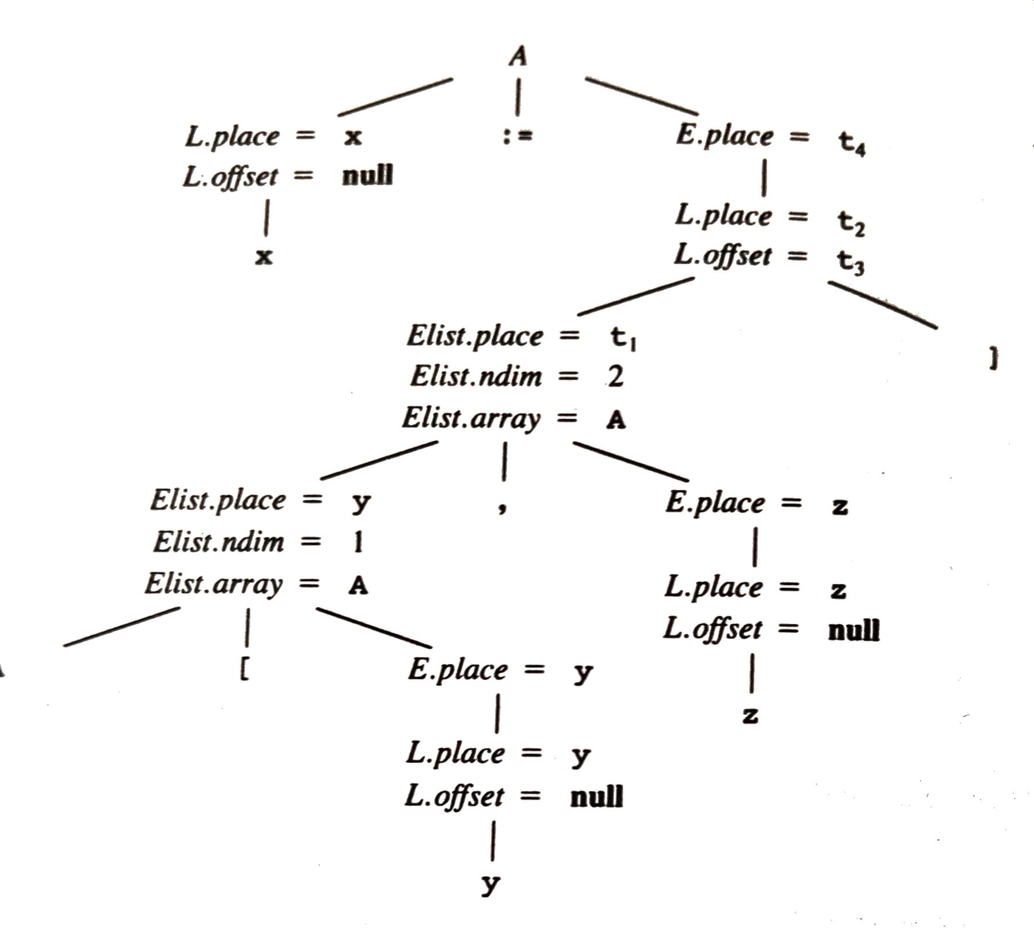
S
t1 : = y * 20
t1 : = t1 + z
t2 := c
t3 := 4 * t1
t4 := t2 [t3]
x := t4
A

Slide 19
Type conversions
E.place = newtemp ()
If E1.type = int and E2.type = int
emit (E.place ‘:=‘ E1.place ‘int +’ E2.place)
E.type := int
else if E1.type = real and E2.type = real
emit (E.place ‘:=‘ E1.place ‘real +’ E2.place)
E.type := real
else if E1.type = int and E2.type = real
u := newtemp;
emit(u ‘:=‘ ‘inttoreal’ E1.place)
emit (E.place ‘:=‘ u ‘real +’ E2.place)
E.type := real
else if E1.type = real and E2.type = int
u := newtemp;
emit(u ‘:=‘ ‘inttoreal’ E2.place)
emit (E.place ‘:=‘ E1.place ‘real +’ u)
E.type := real
else
E.type = type_error

